Slide 1
Introduction to Amazon Web Services
Devdatta Gonsai
Academy Trainer

Slide 2
Course Outline
This slide deck is very much an introductory slide deck into the world of Amazon Web Services, and serves as a method of giving context to learning about developing on the platform,
What is AWS?
What AWS Solves
Key Principles of AWS
AWS Product Categories
Developer Role in AWS Solutions
Tools for AWS Developers

Slide 3
Introduction into Amazon Web Services
What is AWS?
Amazon Web Services (or AWS) is a set of IT infrastructure services that can be used by individuals or organisations – cloud computing at its finest!
Classified as IaaS, but could be argued as a PaaS classification
AWS has a broad number of services spanning across multiple capabilities – the scale and pace of innovation alongside its cross platform support has made it an industry gem
Started in 2006 as a queuing service, but moved to storage soon after and continued to develop into compute-on-demand

Slide 4
Introduction into Amazon Web Services
What AWS Solves
Hosting web applications – can host web applications in a number of different languages
Running legacy applications – cater to applications that need older dependencies
On demand machines – the massive high performance computing batch jobs with the ability to easily control them is a massive asset
Digital Asset Management – store media in the cloud for file sharing of large files

Slide 5
Introduction into Amazon Web Services
What AWS Solves (cont.)
Backup and storage of system data – similar to the benefit brought through Digital Asset Management
Data sharing between applications and organisations
Anywhere access to compute environments
Automatic handling of apps with variable usage patterns – flexible to spikes of access/popularity

Slide 6
Introduction into Amazon Web Services
Key Principles of AWS
Global Regions/Availability Zones – Amazon has a large number of regions they operate in
Global Regions – US West (Oregon, California), South America, Asia Pacific (Singapore, Tokyo), EU
Availability Zones – various areas in a region
What is the best way to distribute AWS?
Web Service Access Strategies (REST/SOAP/Query) – AWS is very web service API friendly
SOAP API is available in some services, but it’s slowly deprecating
REST API is similar to SOAP
Query is used a lot – uses HTTP and XML to operate through URL string
Notes:
Best way to distribute AWS? – Really depends on company and net spend.
Example – AWS went down in around 2011. Reddit went down for half a day because they were based in one region but in multiple availability zones. Netflix stayed alive as they spanned into different regions

Slide 7
Introduction into Amazon Web Services
Key Principles of AWS (cont.)
Machine hours – the amount of time that you’re consuming in an AWS environment
E.g. if you’re using a cluster of 5000 machines in an hour, that’s 5000 machine hours of AWS usage as opposed to 1 hour of machine usage – you get charged for this, so be careful!
Free tiers/pay-as-you-go – you won’t get charged for machine hours until you meet a certain threshold
AWS is all about self-service pay as you go
High reliability and fault tolerance – mask any underlying failures so your data isn’t affected
Eventual consistency – atomic transactions aren’t instant, but sync up eventually
Notes:
Eventual consistency example
If I delete a row from a database table then immediately query the table I may get that row back, but after a few moments, everything sync’s up and the row will be gone

Slide 8
Introduction into Amazon Web Services
Key Principles of AWS (cont.)
Access Credentials
Account ID – your actual ID with Amazon Web Services user
Access Key ID – similar to a username
Secret Access Key – a password (don’t share it!)
Certificates – used mainly for SOAP calls
Key Pairs – public/private key pairs for accessing sensitive information

Slide 9
Introduction into Amazon Web Services
Product Categories
Compute Services – give you on-demand raw virtual machines (Different OS types are available)
Storage Services – lets you store large blocks of unstructured content
Database Services –allow you to store tabular data in a variety of ways
Networking Services – provide technologies for identifying (DNS) resources and connecting resources to on-premise assets (maybe through VPN)?

Slide 10
Introduction into Amazon Web Services
Product Categories
Messaging Services – enables rich communication scenarios between systems (web services)
Content Delivery Services – provide edge locations for frequently accessed content
Deployment and Management Services – enable packaging, securing and monitoring AWS applications

Slide 11
Introduction into Amazon Web Services
Developer Role in AWS
When calling AWS a IaaS, it seems like a tool aimed at the guys who set up servers and networks as opposed to developers, but this isn’t the case – developers use AWS too!
Host development environment – a VM with VB, SQL etc. to access from anywhere
Deploy Java/.NET web applications
Use storage services to store content used by apps
Leverage cloud databases
Secure an application
Create a messaging layer between components

Slide 12
Introduction into Amazon Web Services
Developer Role in AWS
Developers can interact with AWS through visual tools or through an API
SOAP/REST/Query
SDK’s – Java, Ruby, etc.
Use SDK’s to abstract away from the API use
Command Line Interface (Java)

Slide 13
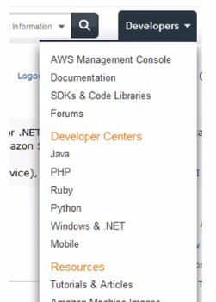
Introduction into Amazon Web Services
Tools for AWS Developers
The Management Console provides a one-stop UI for provisioning and interacting with AWS services
SDK and Development Centres for Android, iOS, Java, .NET, PHP, Ruby
Amazon Machine Images (AMIs) that come pre-loaded with application environments
Community forums and documentation – whitepapers, tutorials, API guides

Slide 14
Managing AWS Solutions
Aspects of AWS Solution Management
AWS removes some of the operational tasks that we are familiar with in an on-site hosting model
We don’t have to deal with cooling, space concerns, or maintaining infrastructure
For some AWS services, there is no visibility to the underlying hardware
Managing these solutions involves moving further up the stack
Regardless of what aspect of AWS you are using, the user is responsible for provisioning, securing and monitoring their solution
Additional tasks include provisioning, storage space, enabling open ports, etc.

Slide 15
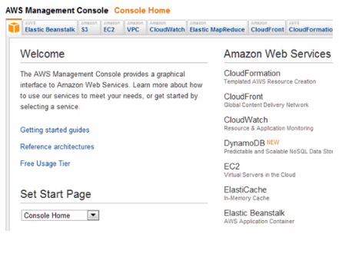
Managing AWS Solutions
Using the AWS Management Console
The AWS Management Console is the central place for provisioning, monitoring and interacting with AWS
Very rich and strong web-based environment
Has product-specific sub sections
Also hosts overall health dashboard that shows performance of a product in a given region

Slide 16
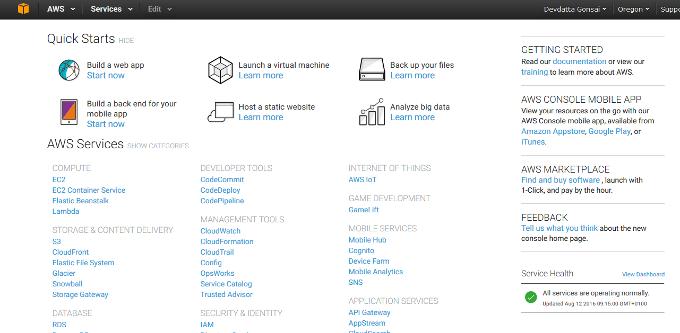
Managing AWS Solutions
The Management Console
Notes:
Loads of useful links to services you’ll have or that are recommended to you
Set the homepage
Quick Starts
Marketplace

Slide 17
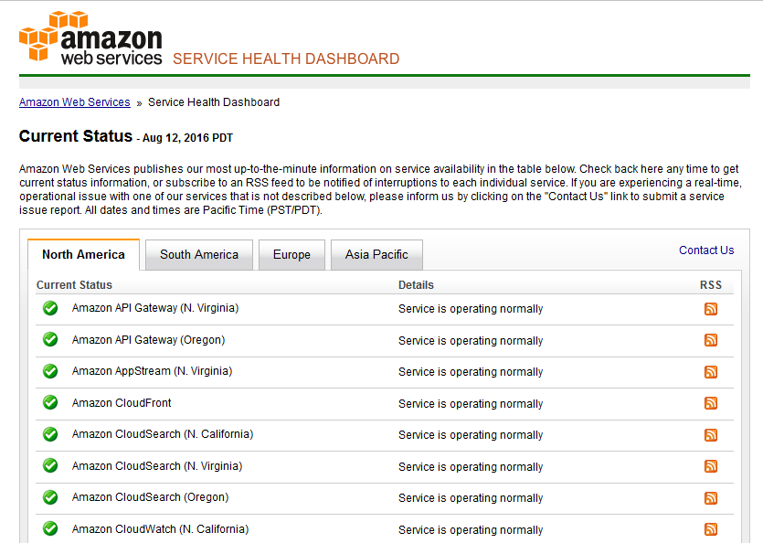
Managing AWS Solutions
Service Health Dashboard
Notes:
Status.aws.amazon.com
Shows how each service is doing where it’s based

Slide 18
Managing AWS Solutions
IAM in AWS - Introduction
AWS Identity and Access Management (IAM) is a service for securely controlling access to other AWS services
Stores users, groups, and secures access through policies
An IAM “user” is very similar to a login for an operating system – it could be a person or a system
Groups can provide another way to align access to resources
They don’t have credentials
Groups can’t contain other groups
Supports a variety of use cases for access to resources, identity federation, mobile/browser access
Integrates with a variety of AWS services and is free to use – can also be through API’s

Slide 19
AWS and DevOps
Introduction
AWS allows for management and scalability of machines in the cloud
Intrinsically, DevOps will tie into this quite nicely
The majority of companies have tied AWS into their CI pipeline in a production environment
Being able to create machines in the cloud allows for the alleviation of physical computing resources to be used for running tools such as Jenkins, Jira, etc.

Slide 20
AWS and DevOps
Amazon EC2
Amazon Elastic Compute Cloud (Amazon EC2) is a web service that provides resizable compute capacity in the cloud
Designed to make web-scale cloud computing easier for developers
It has a simple interface which allows you to obtain and configure computing resources in the cloud
Uses AMI’s (Amazon Machine Images) to configure OS for a machine
Essentially, it fulfils the role of VirtualBox in a cloud-based environment

Slide 21
AWS and DevOps
“Elasticity”
Elasticity is a buzzword that’s thrown around often when discussing the benefits of AWS, but what does it actually mean?
Elasticity refers to the ability to adapt to both an increase and a decrease in workload by provisioning and deprovisioning resources in an autonomic manner
The ability to adapt to this in a DevOps environment is key, which explains why AWS is being picked up more and more in the industry

Slide 22
AWS and DevOps
AWS and Puppet
When talking about provisioning, of course, the use of Puppet is integral to this
Provisioning machines in the cloud is very similar to doing it in a local environment, but the constraint of local computing resource use is now gone
In the exercises, you’ll be setting up Puppet on AWS machines and configuring the master agent architecture

Slide 23
Devdatta Gonsai
Academy Trainer

